Slide 1
Age Perception Challenge
Task 1
Computer Vision 2023-2024
Joel Dieguez and Clàudia Valverde

Slide 2
Data Analysis
Data Augmentation
Experiment 1
Testing data augmentation
Leaky-ReLu
Xception
Experiment 2
Experiment 3 (the chosen one)
Conclusions and Future Work
Outline

Slide 3
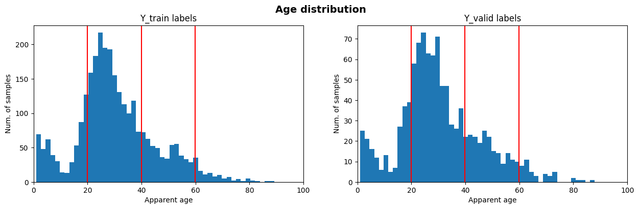
Data Analysis

Slide 4
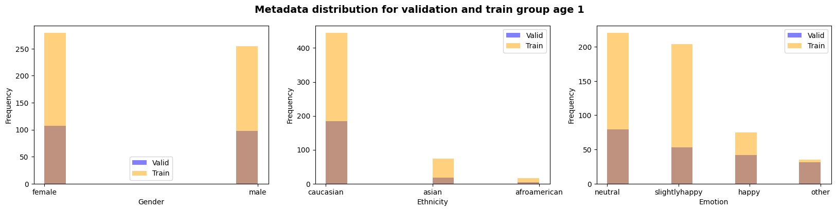
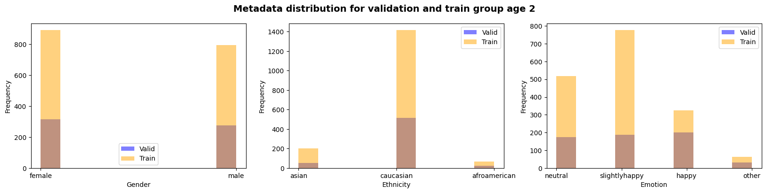
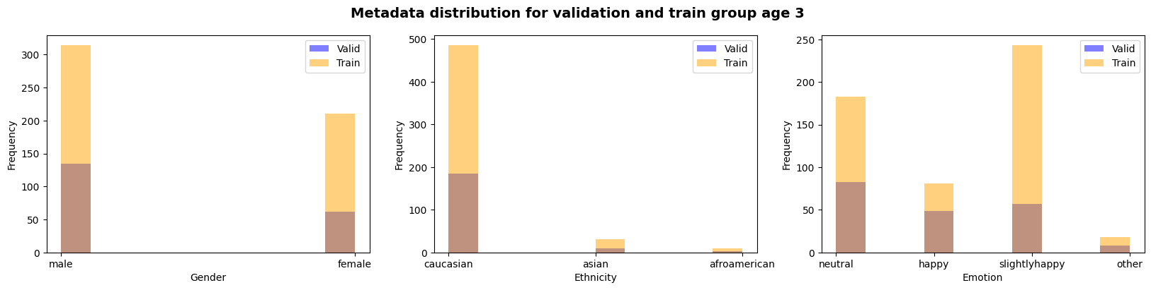
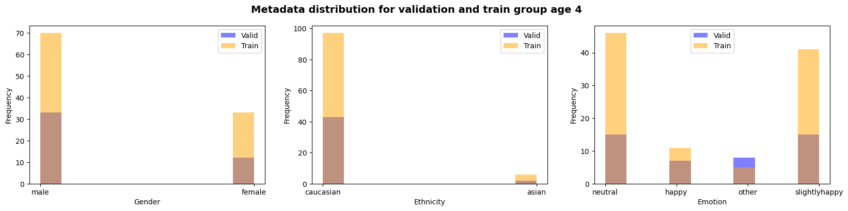
Data Analysis
AGES
Group 1: 0 - 20
Group 2: 21 - 40
Group 3: 41 - 60
Group 4: 61 - 100

Slide 5
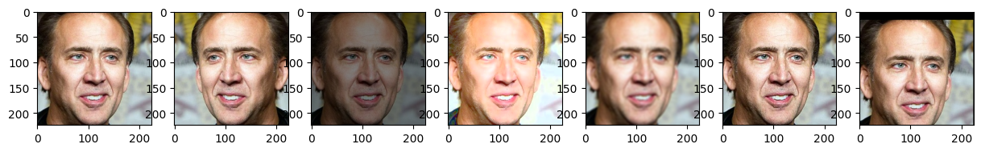
Data Augmentation
Sharpness

Slide 6
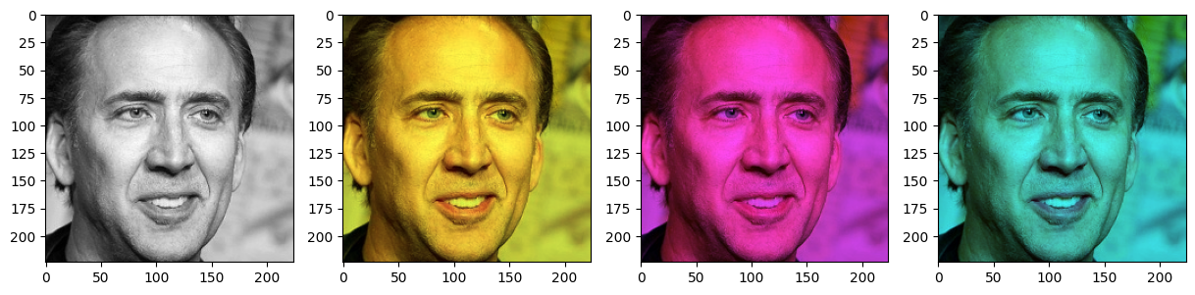
Data Augmentation
Color modification

Slide 7
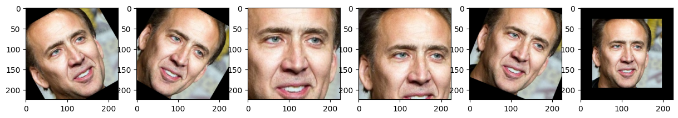
Data Augmentation
Linear transformations

Slide 8
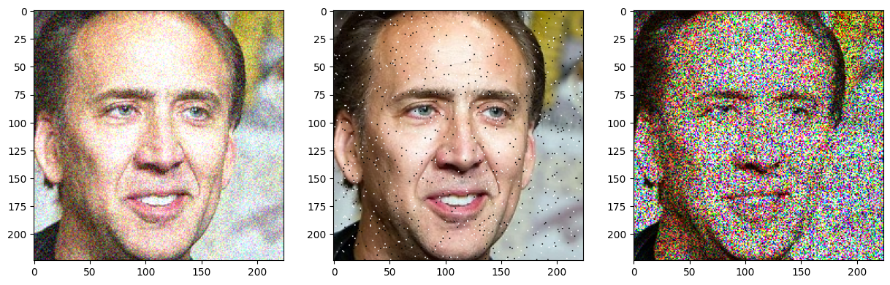
Data Augmentation
Noise

Slide 9
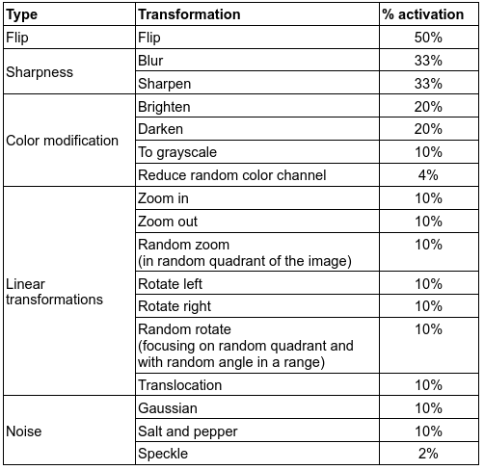
Data Augmentation

Slide 10
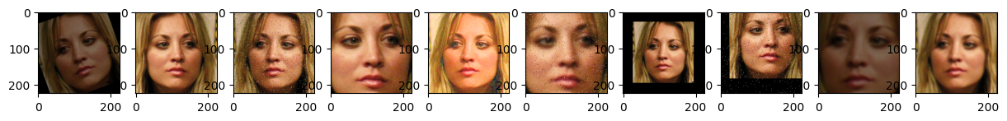
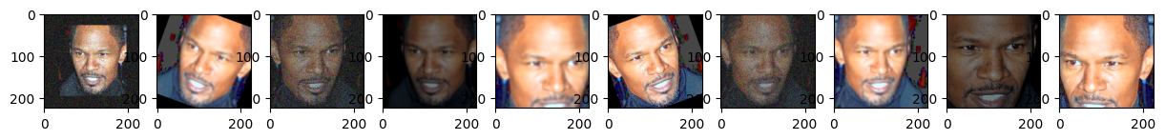
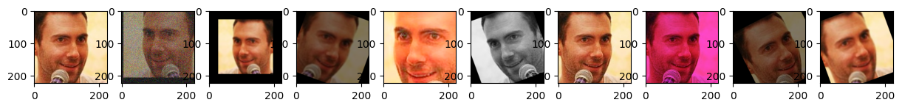
Data Augmentation
Combinations of transformations based on random probabilities function

Slide 11
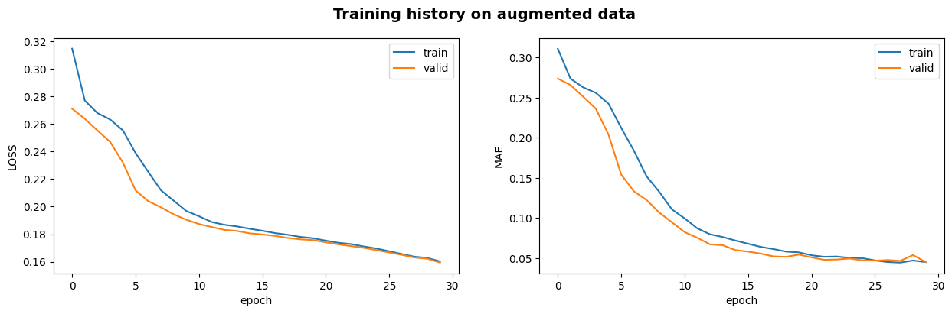
Experiment 1 -> extreme and soft
Testing data augmentation with ResNet50 stage 1 model
MAE (model age_ethnicity, validation set) = 4.520
- - - -
MAE (model age_ethnicity, TEST set) = 4.815

Slide 12
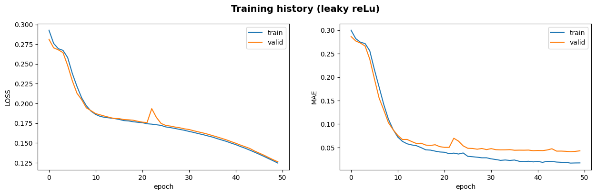
Experiment 1
2) Stage 1 ResNet50 with Leaky ReLu as activation for fc layers
MAE (model leaky relu, validation set) = 4.290
-----
MAE (model leaky relu, TEST set) = 5.219

Slide 13
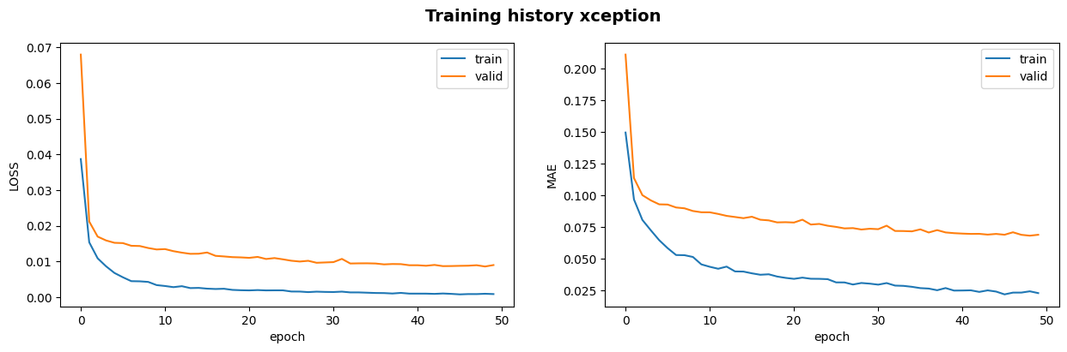
Experiment 1
3) Xception model pre-trained on ImageNet
MAE (model leaky relu, validation set) = 6.811
- - -
MAE (model leaky relu, TEST set) = 8.134

Slide 14
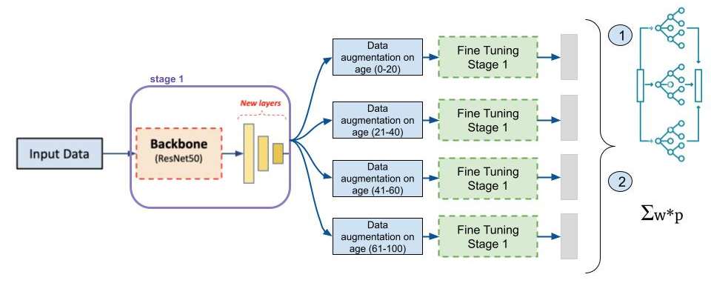
Experiment 2
stacking
weighted average

Slide 15
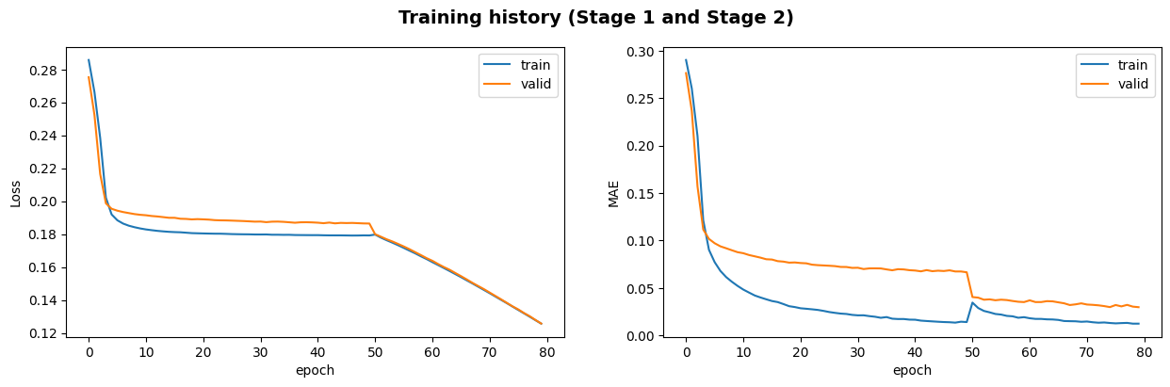
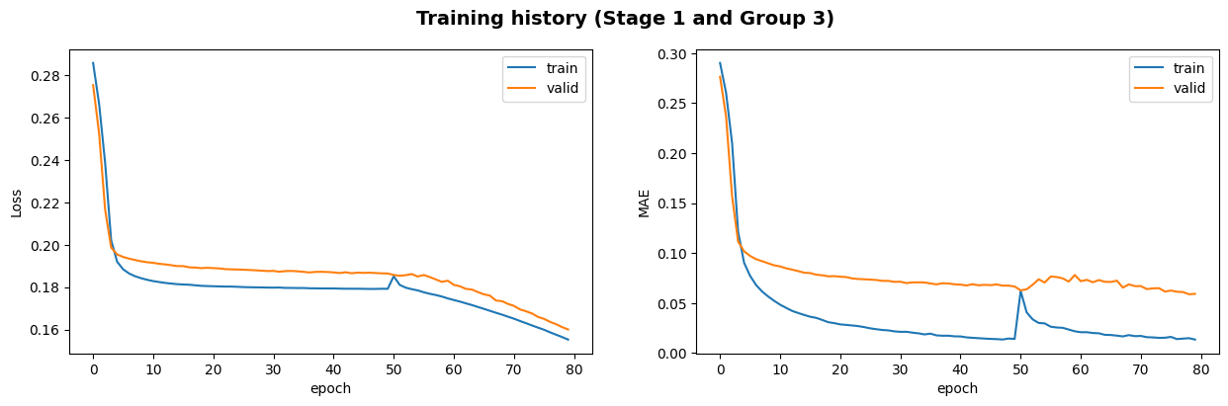
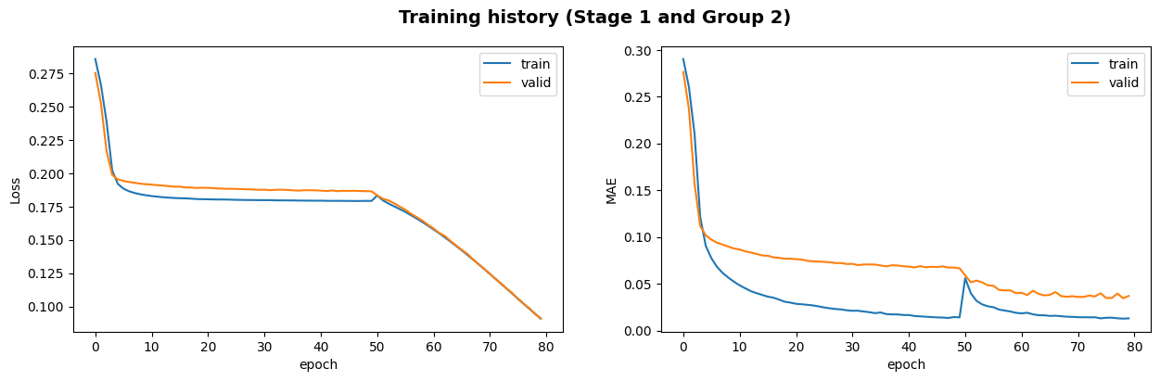
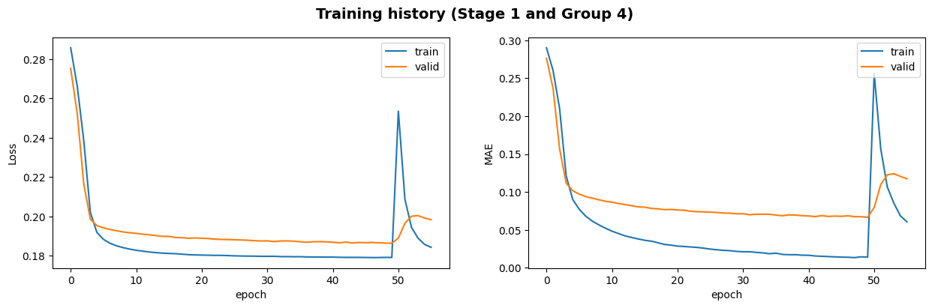
Experiment 2 - fine-tuning plots
group 1
Group 1
group 3
MAE (model age_ethnicity, validation set) = 2.976
MAE (model age_ethnicity, validation set) = 5.915
group 2
group 4
MAE (model age_ethnicity, validation set) = 3.122
MAE (model age_ethnicity, validation set) = 8.171

Slide 16
Experiment 2
stacking
stack fine-tuned predictions (creating new feature)
train meta-model → RandomForestRegressor
make final predictions
MAE (model age_ethnicity, validation set) = 2.778
- - -
MAE (TEST set) = 6.277
weighted average
function that computes a weighted probability depending on the group of age the prediction has been made
MAE (model age_ethnicity, validation set) = 7.483
- - - -
MAE (TEST set) = 9.054

Slide 17
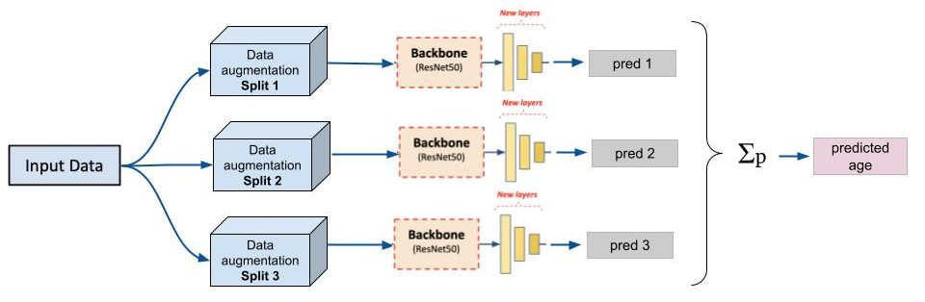
Experiment 3

Slide 18
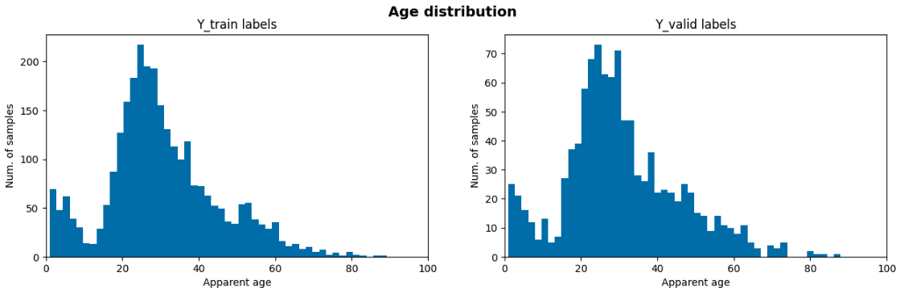
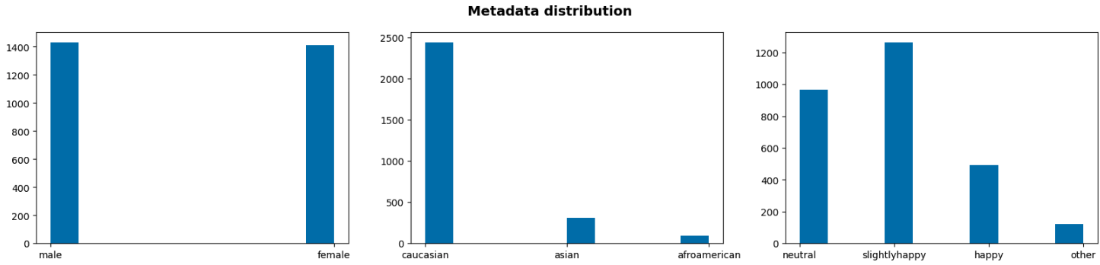
Experiment 3 - data augmentation
Notes:
nse com posa rl fons blanc ajlfnfdgkj,wenfsbd

Slide 19
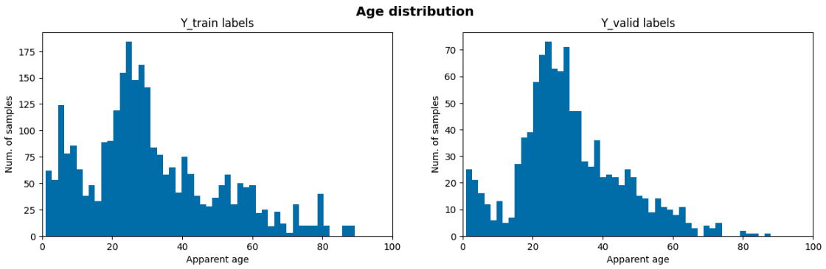
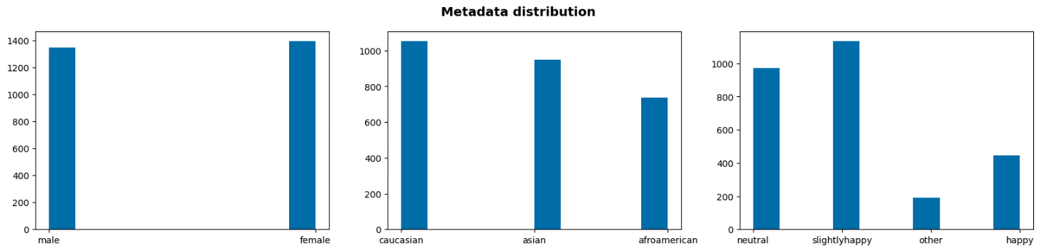
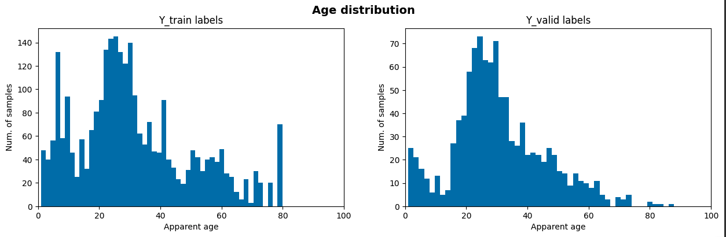
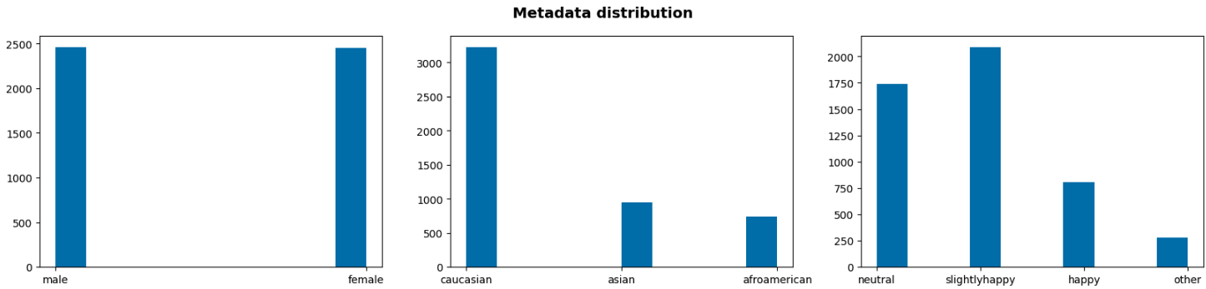
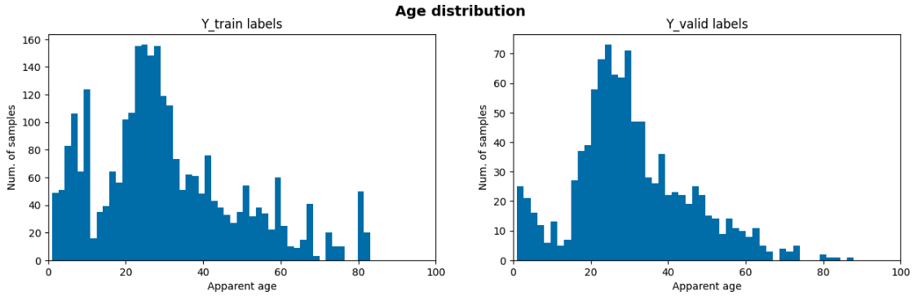

Split 1
Split 2
Split 3

Slide 20
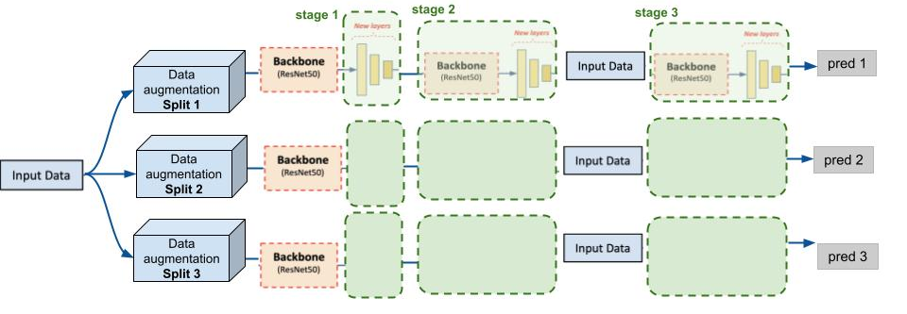
Experiment 3 - Training
Notes:
nse com posa rl fons blanc ajlfnfdgkj,wenfsbd

Slide 21
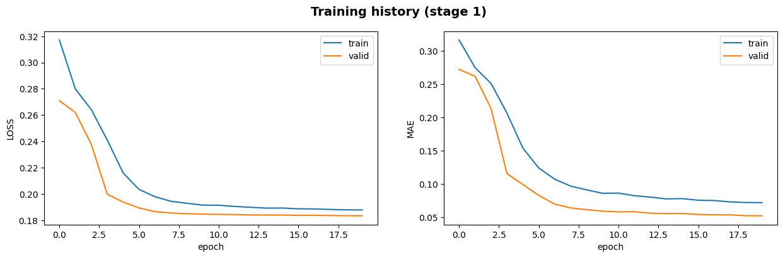
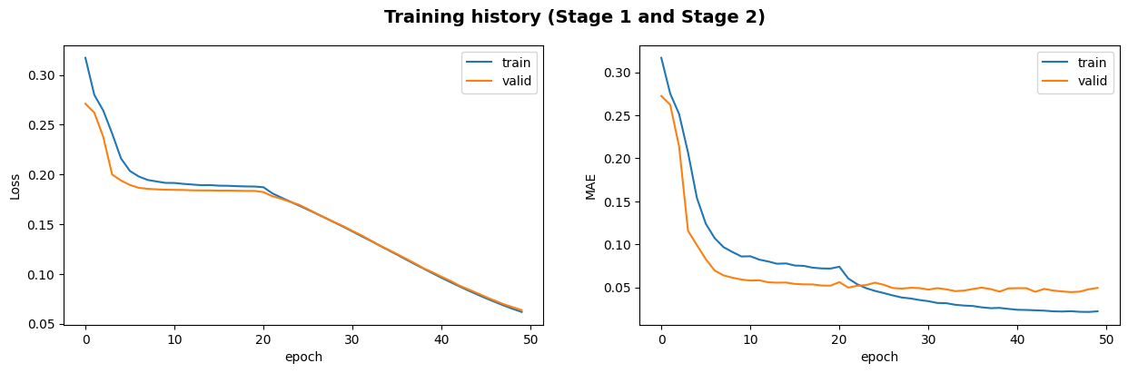
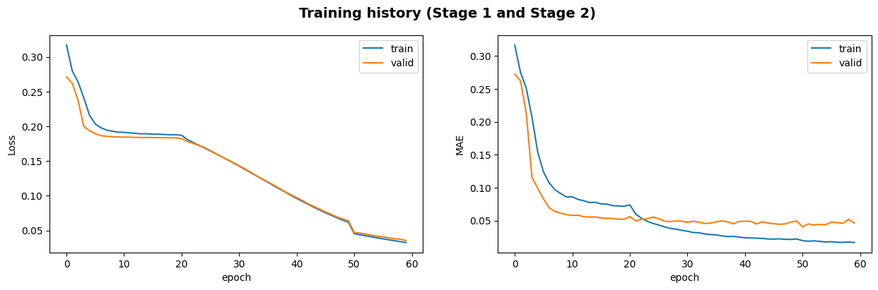
Experiment 3 - Training
Stage 1
30 epochs w/ early stopping
MAE (model stage 1, validation set) = 5.192
30 epochs
MAE (model stage 2, validation set) = 4.929
Stage 2
Stage 3
10 epochs
MAE (model stage 3, validation set) = 4.621
Notes:
nse com posa rl fons blanc ajlfnfdgkj,wenfsbd

Slide 22
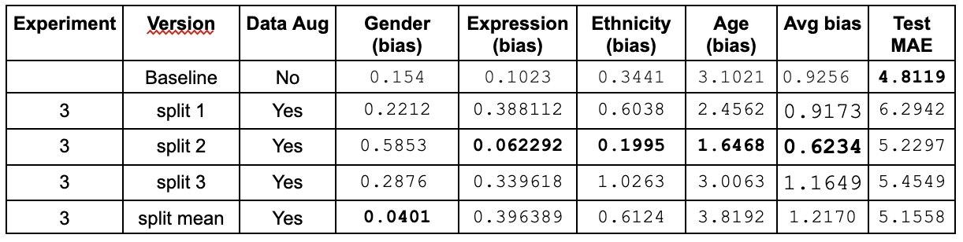
Experiment 3 - Results
Notes:
nse com posa rl fons blanc ajlfnfdgkj,wenfsbd

Slide 23
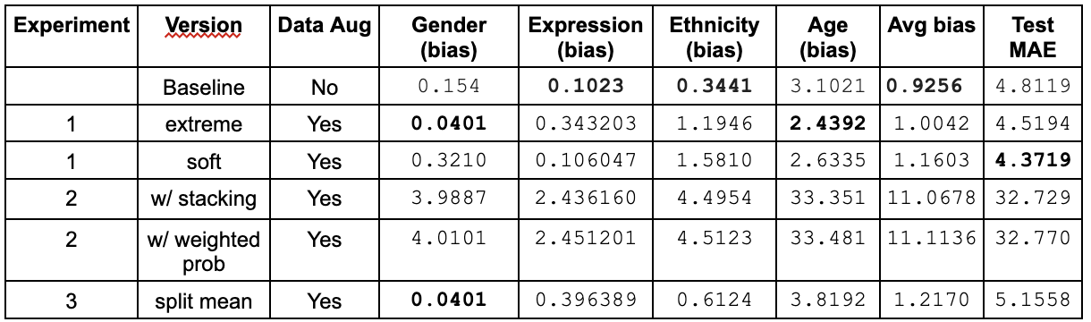
Final Results
Notes:
nse com posa rl fons blanc ajlfnfdgkj,wenfsbd

Slide 24
Conclusions and Future Work
Limitations
Challenges in improving the starting-kit model and addressing biases effectively
Hard to obtain well represented datasets
Overfitting
Time and computation limitations
Future Work
Improve model and training strategy
Explore regularization techniques and hyperparameters

Slide 25
Thanks, any questions?

